Slide 1
Wavelength
Low-fi Prototyping
Team 2: Connor, Corbin, Sebastian, Steven

Slide 2
Overview
Mission Statement and Value Proposition
Problem/Solution Overview
Selected Interface
Lo-Fi Prototype
User Testing

Slide 3

Mission Statement
Value Proposition
Our aim with Wavelength is make it easier for people with similar music tastes to connect. We believe music is better when you share it with others!
Connecting compatible music listeners.

Slide 4
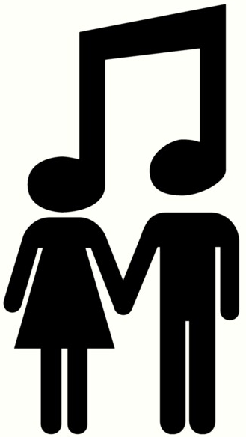
Problem/Solution Overview
It can be difficult to find friends with the same taste in music. There is a vast pool of musical genres and artists, AND growing number of ways to consume music.
Our solution, Wavelength, is a platform where users are matched with one another based on sampled music taste and geographical proximity. We encourage users to chat about their music taste, share songs with each other, or even meet in real life and go to a concert together.
Important distinction to be made: Wavelength is NOT a competitor to music streaming or purchasing platforms.

Slide 5
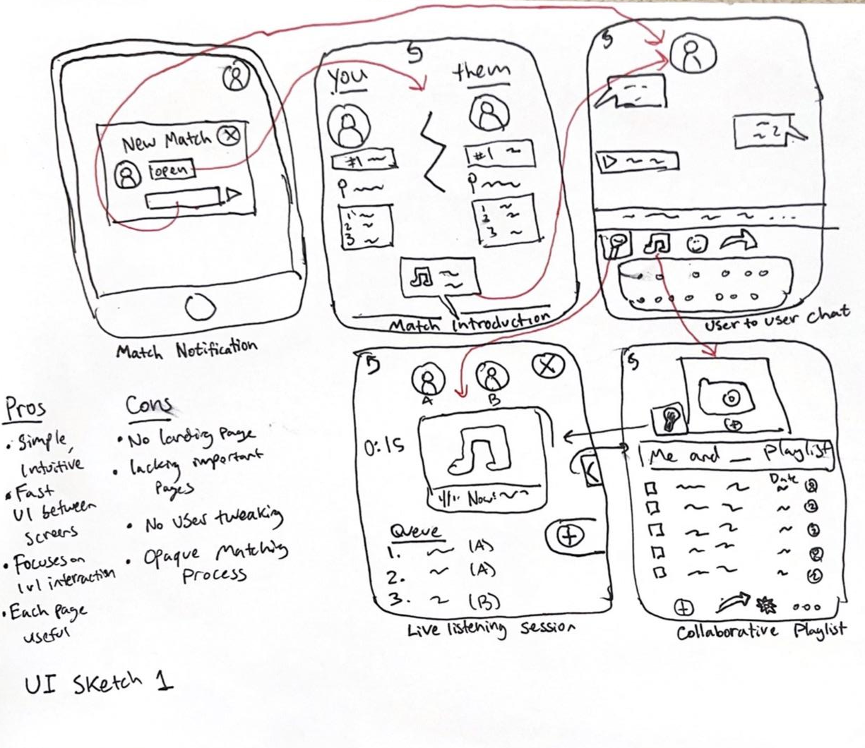
Selected Interface
After numerous trial sketches, we settled on this interface because it best accomplished our goals of simplicity and minimizing clicks to get to important pages.

Slide 6
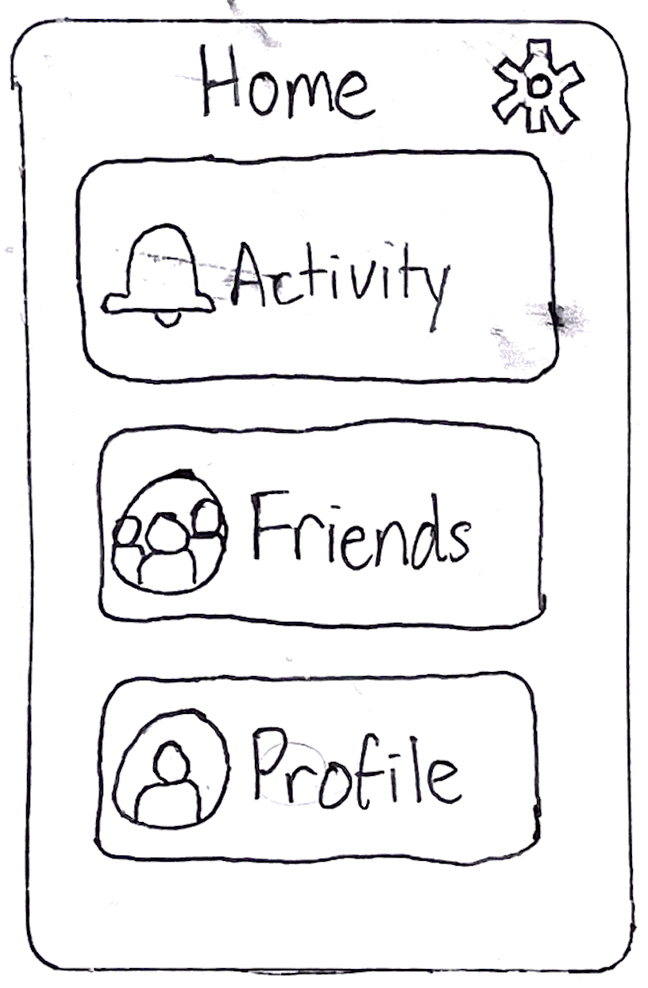
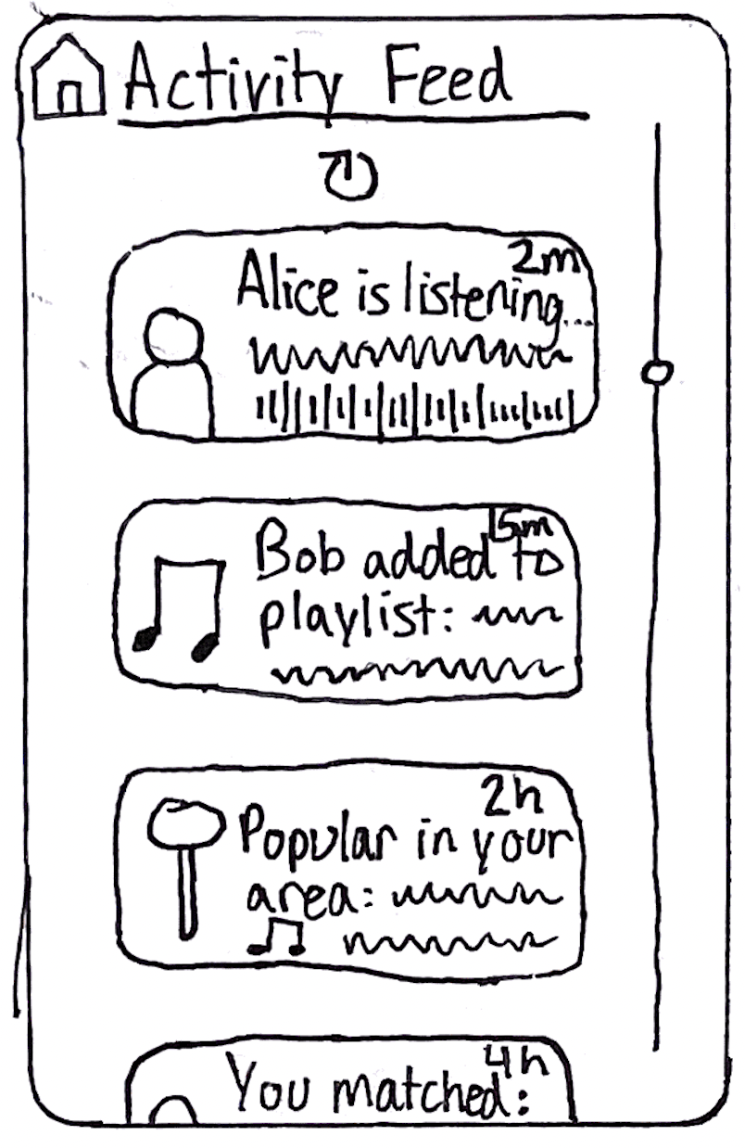
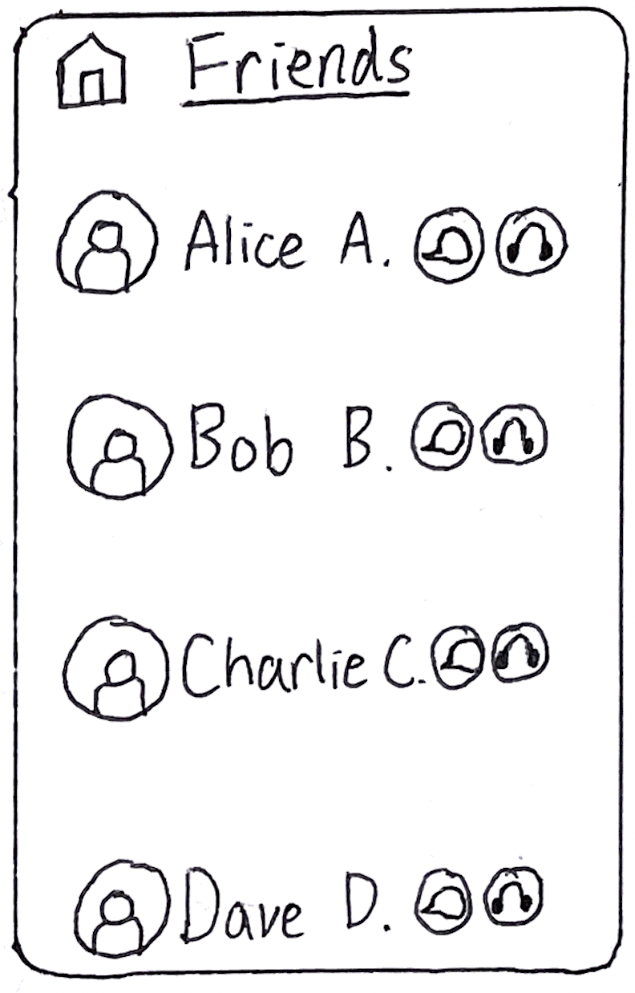
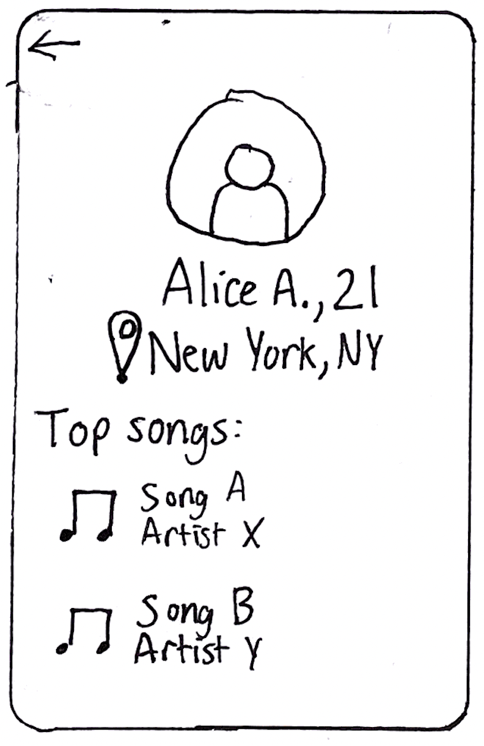
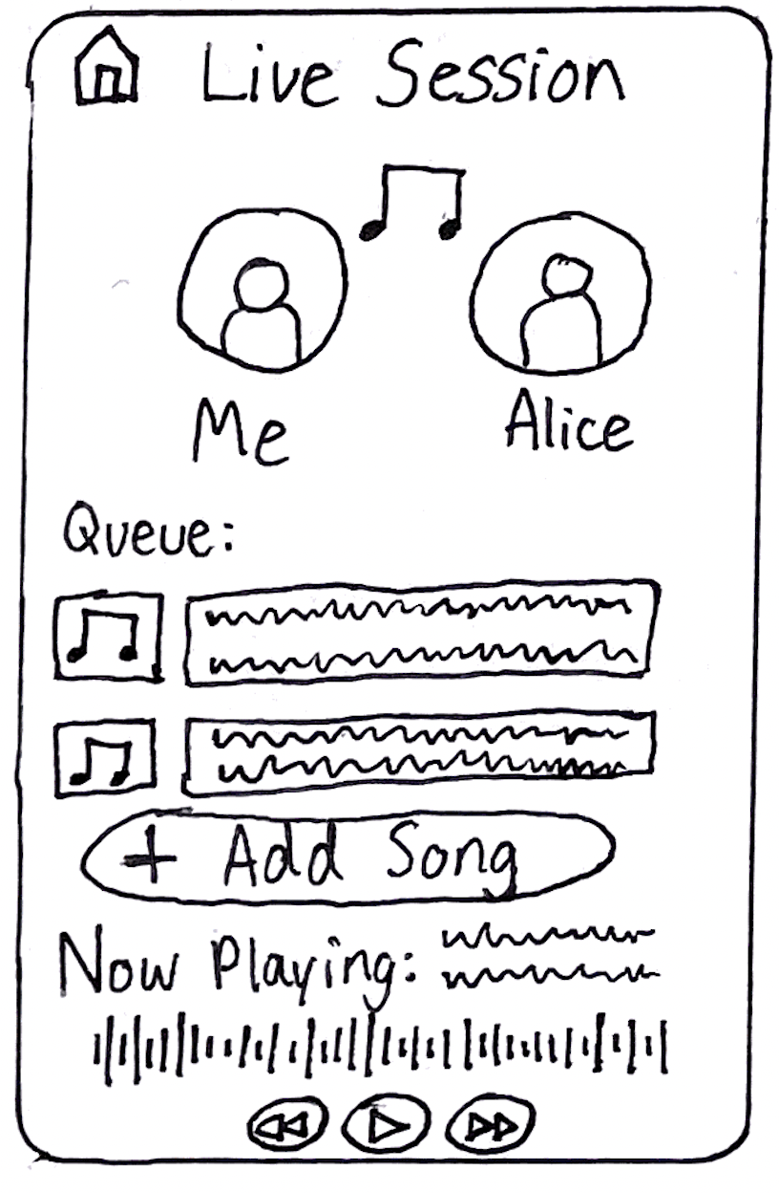
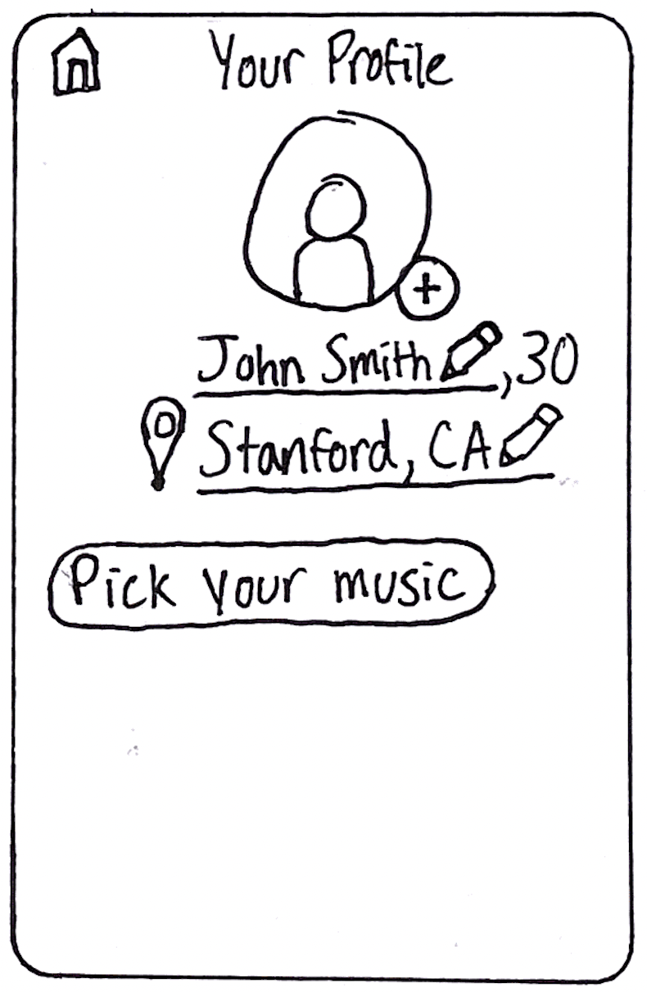
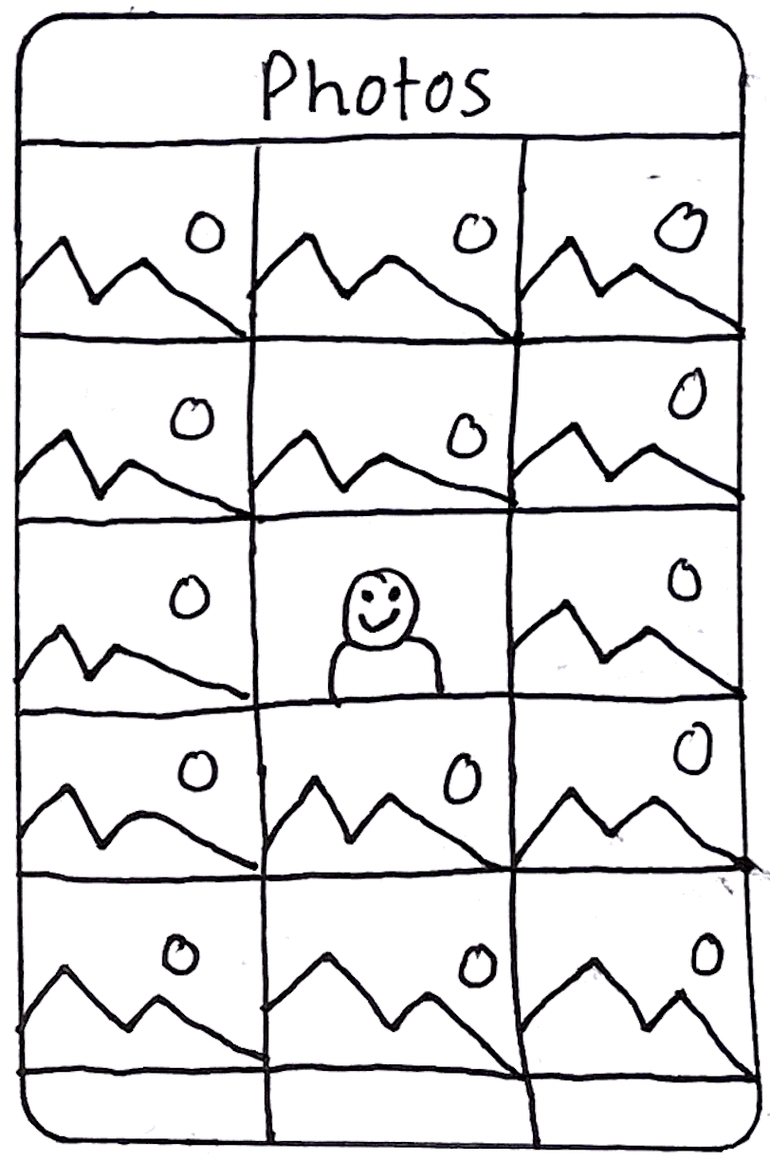
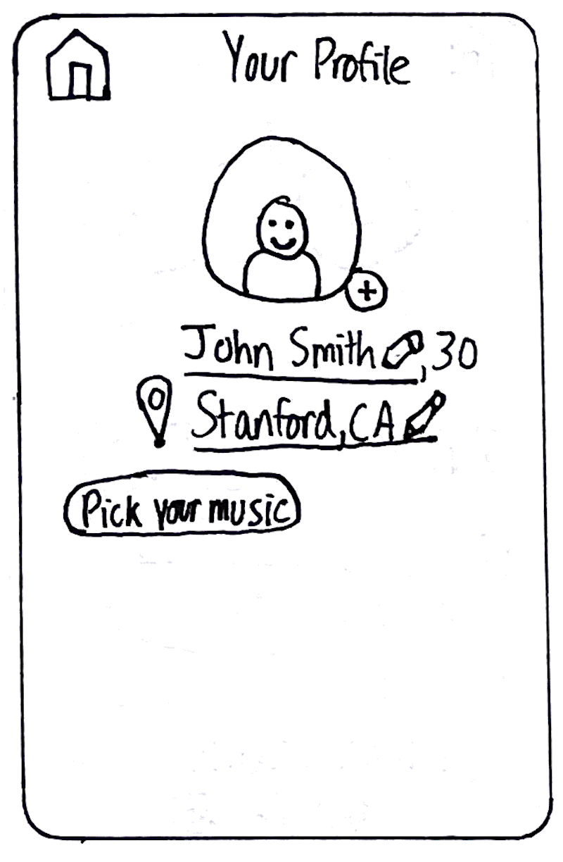
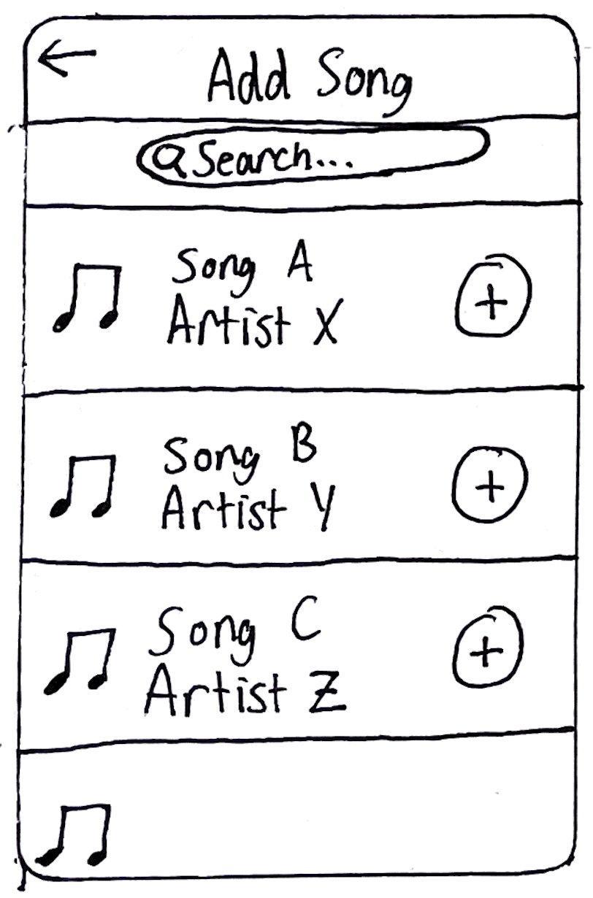
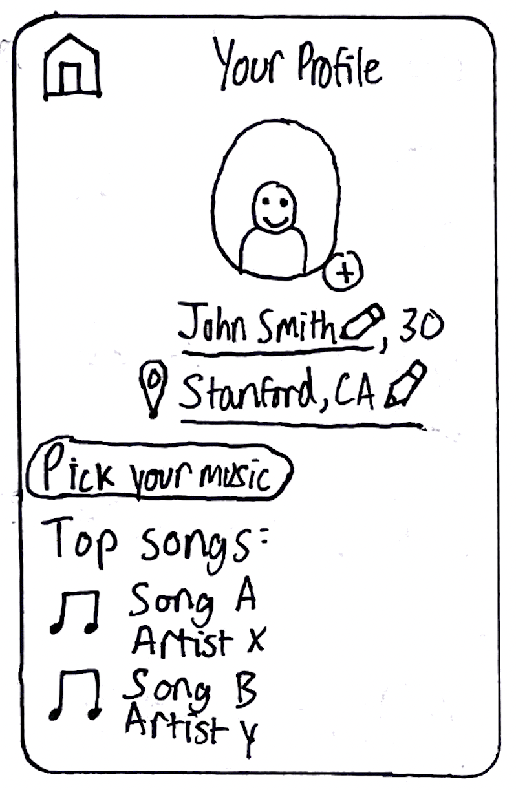
Lo-Fi Prototype Structure
We utilized Marvel App to link our sketched UI together with hotspots.

Slide 7
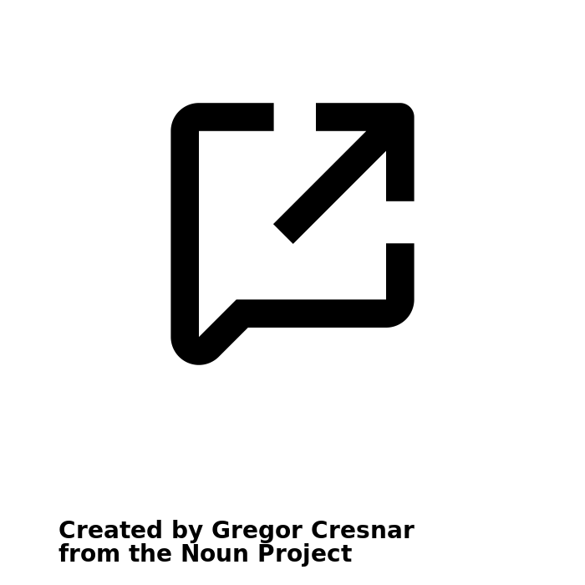
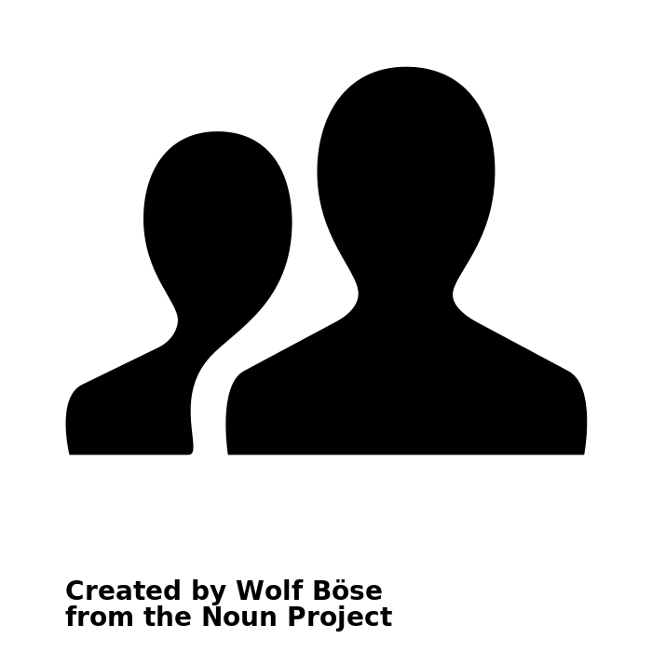
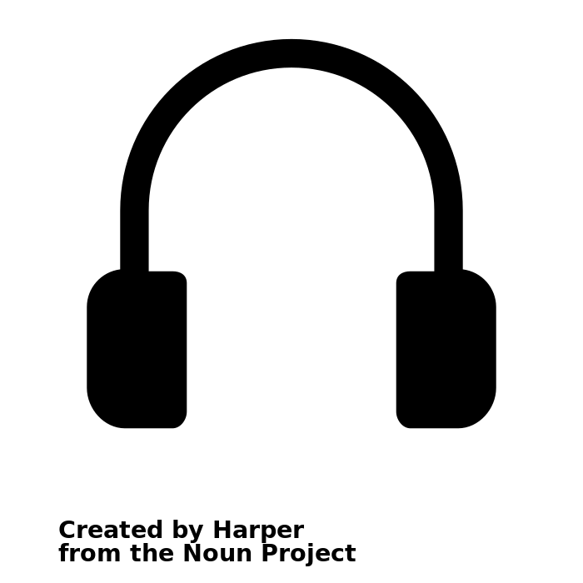
Tasks
Simple
Medium
Complex
Create a profile
View a friend’s profile
Live listener-to-listener interaction

Slide 8
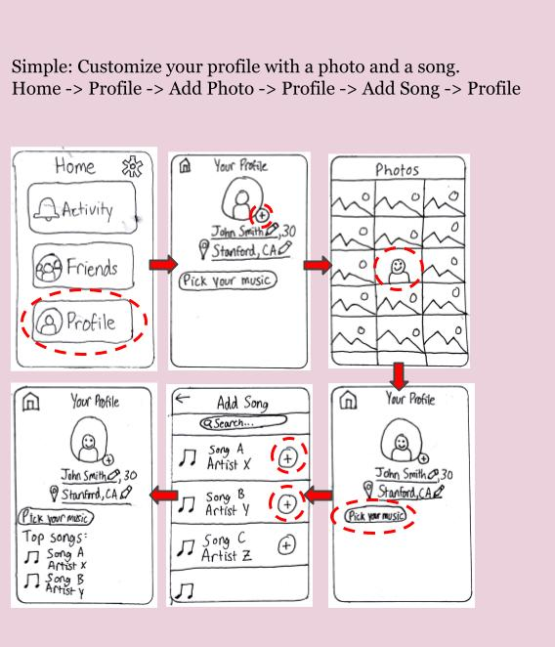
Simple Task: Create a Profile

Slide 9
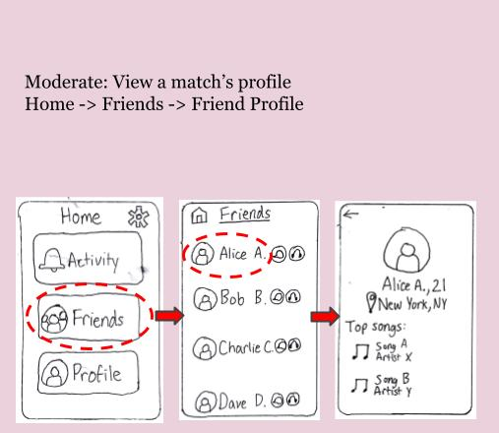
Moderate Task: View a friend’s profile

Slide 10
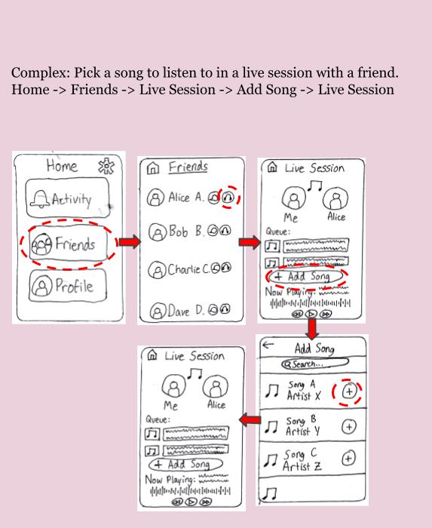
Complex Task: Listen live with a friend

Slide 11
Experimenting

Slide 12
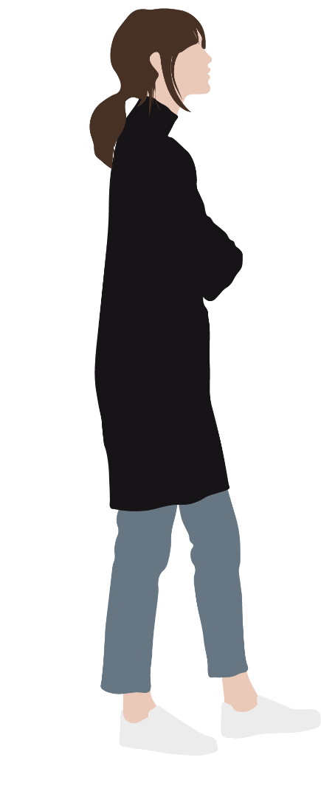
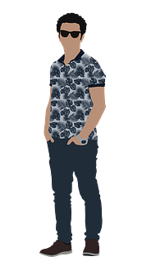
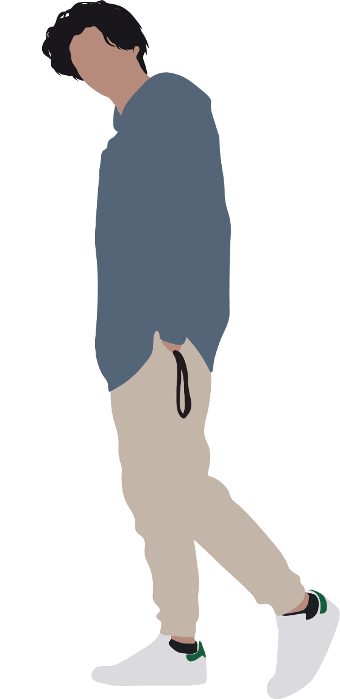
Participants
(selected for their niche interests in music and their interest in making playlists)
1
2
3
Listens to music for 6 hours per day, fan of classic hip hop
Avid playlist builder, fan of 70s rock
Listens primarily to music popular outside the United States

Slide 13
Experimental Method
Interview with (1) was in person, (2) and (3) were over Zoom (using the proposed technique of “hugging” the laptop).
Used Marvel, we created a digital Lo-Fi prototype.
Stressed our desire for ease of use and navigation.
Had participants complete tasks one at a time.
We timed each task.

Slide 15
Results
Timing Data (in seconds)
In addition to this data, the experiment facilitator would observe when a participant was struggling with a particular path and inquire with the participant what was confusing them.
 | Participant 1 | Participant 2 | Participant 3
Simple: customize profile | 0:07 | 0:08 | 0:13
Moderate: view friend’s profile | 0:07 | 0:24 | 0:08
Complex: add song in live session | Incomplete (hot zone was incorrect) | 0:11 | 0:16

Slide 16
Results
Discerning “view match’s profile” versus “view friend’s profile” was an artifact of a previous design
 | Participant 2
Simple: customize profile | 0:08
Moderate: view friend’s profile | 0:24
Complex: add song in live session | 0:11
UI was “straightforward”
Participants liked the design for our “Live Listening” screen

Slide 17
Suggested UI Changes
Some participants noted that the UI for the app was “generic”. They suggested that we “spice it up”
A participant recommended making it clearer how to create a live listening session; the headphone icon wasn’t clear enough
Many of the issues which occurred weren’t with the content of the prototype, but with how we constructed it on Marvel.
Balance of simplicity of function, with an engaging design.
Create a more engaging UI design, while maintaining an seamless flow between screens.

Slide 18
Summary

Slide 19
Our aim with Wavelength is make it easier for people with similar music tastes to connect. We believe music is better when you share it with others!

Slide 20
“Connecting compatible music listeners”
Wavelength

Slide 21

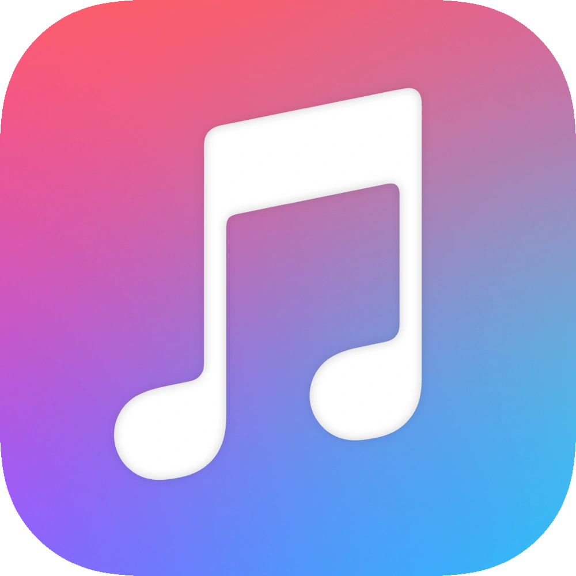

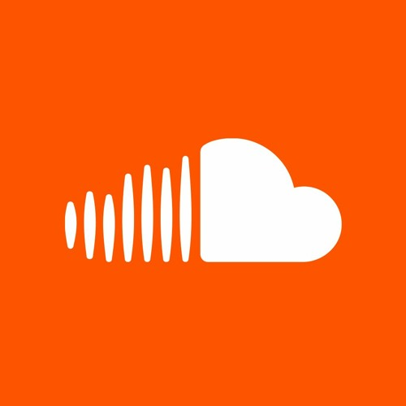




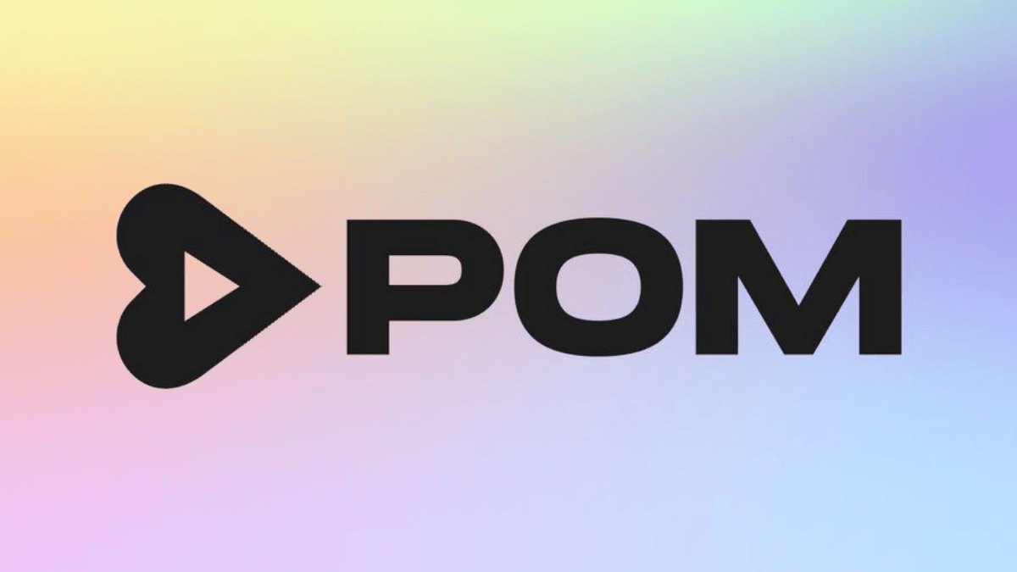
WAVELENGTH
Finding People
Finding Music

Slide 22
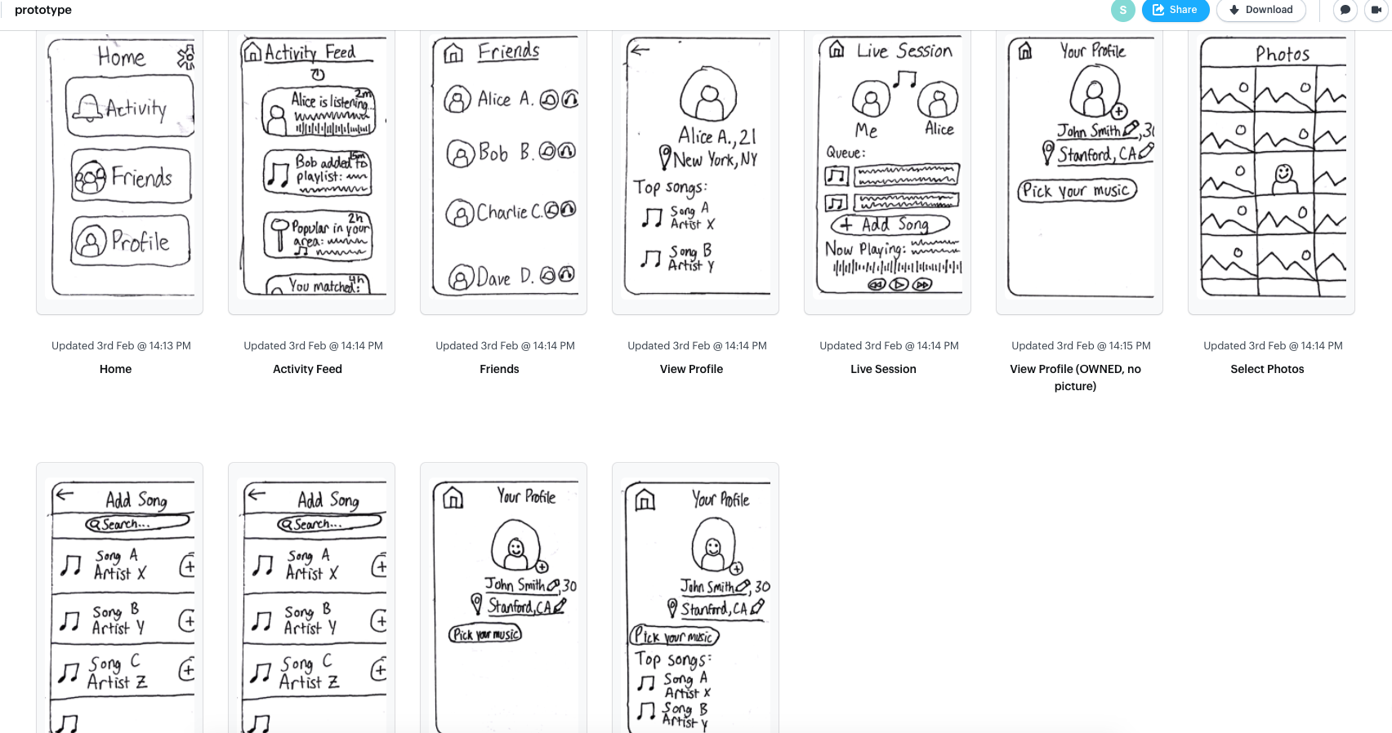

Slide 23


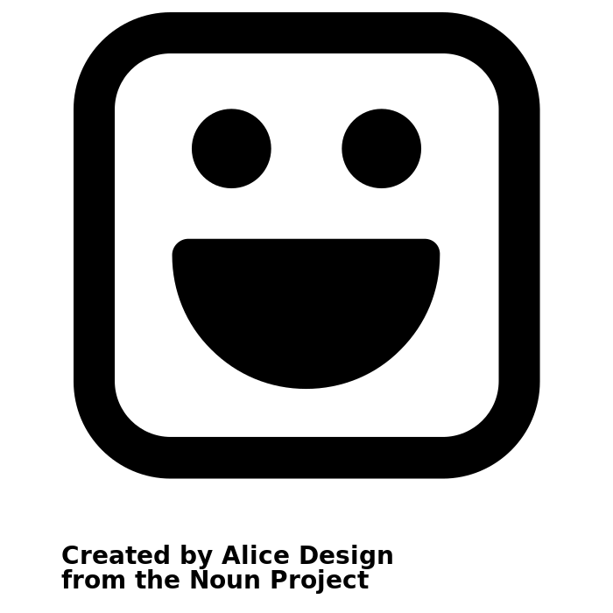
UI Design Going Forward
Simplicity
Focus on Live Listening Feature
More engaging design
Simplicity and fun may conflict. User testing showed us that there is a fine balance between keeping designs simple while also keeping the user engaged.

Slide 24
Thank You!

